Slide 1
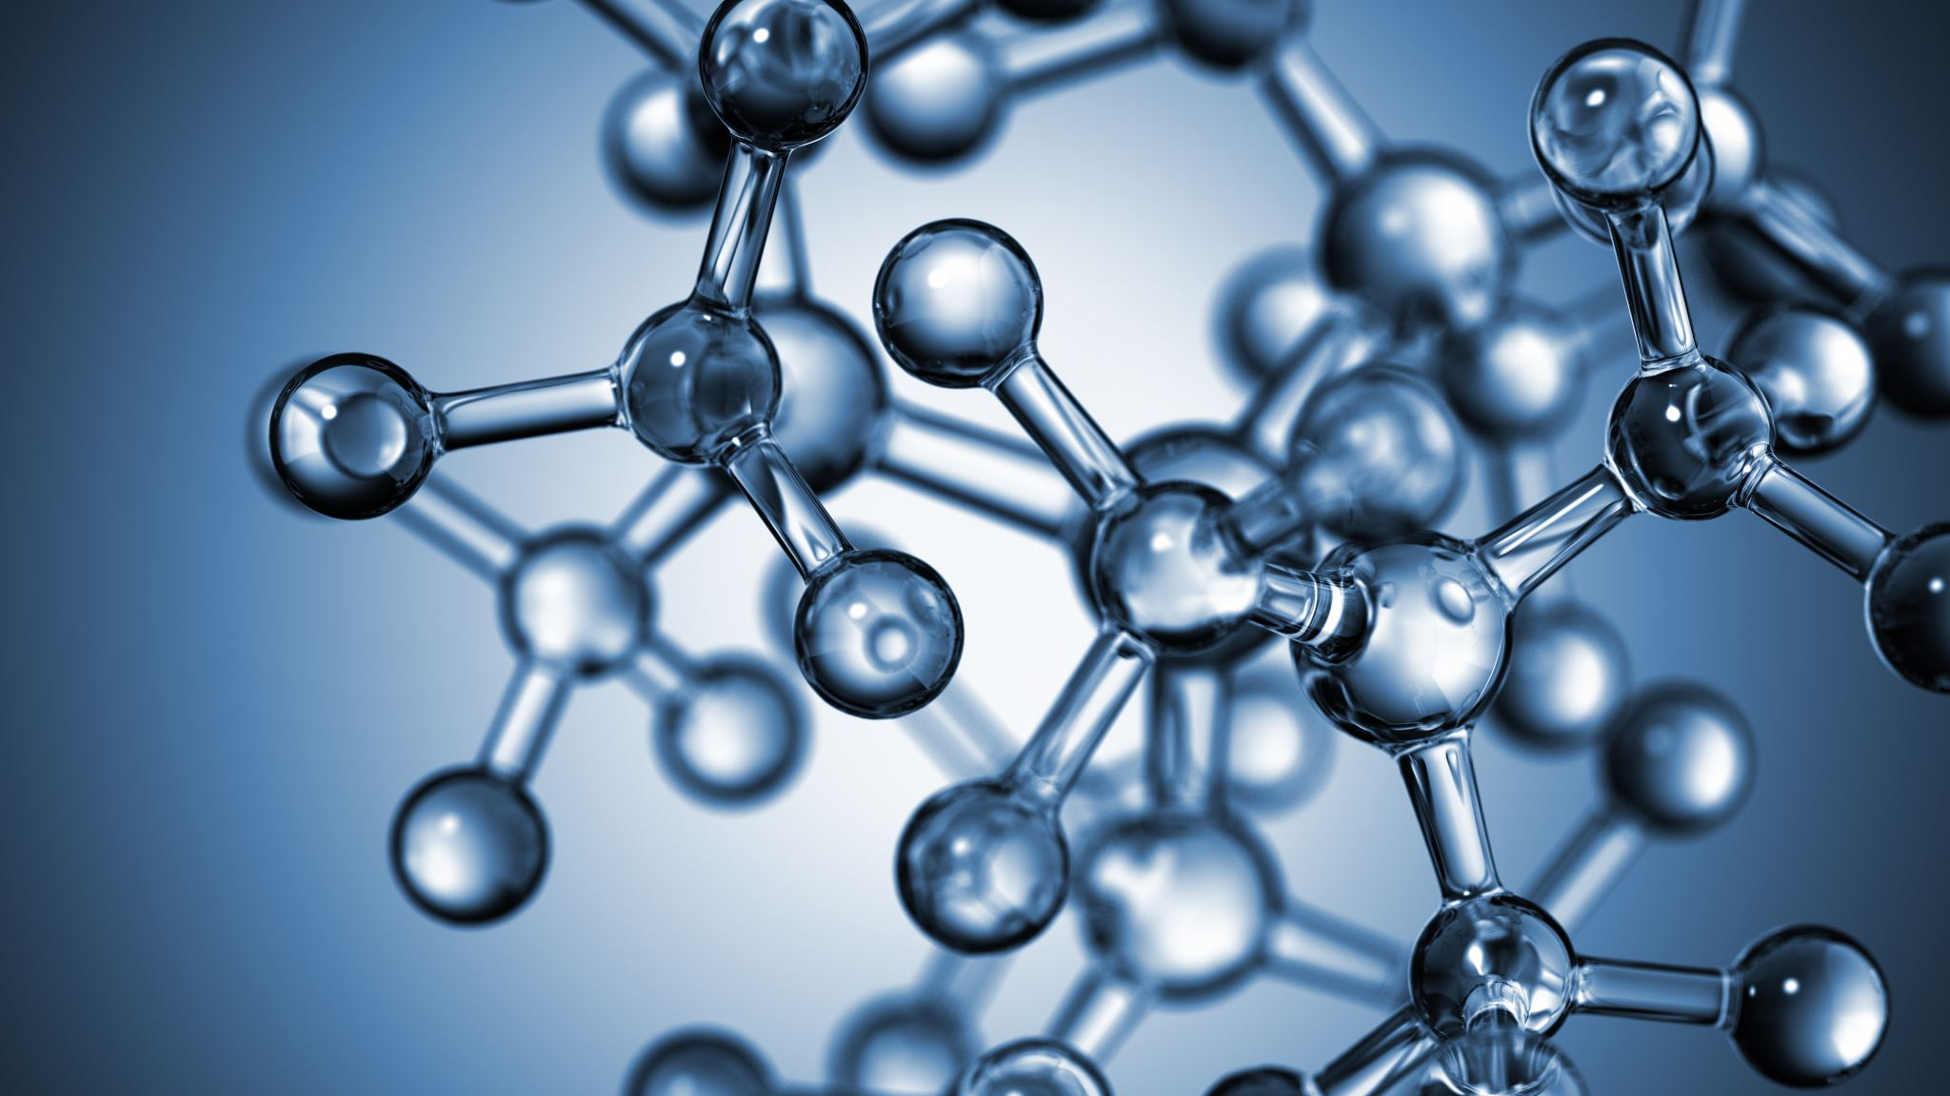


Atomic and Molecular Science: Basic Concepts and Laws of Chemistry
Al-Farabi Kazakh National University
Faculty of Chemistry and Chemical technology
Department of General and Inorganic Chemistry
pHd Bakhadur askar

Slide 2
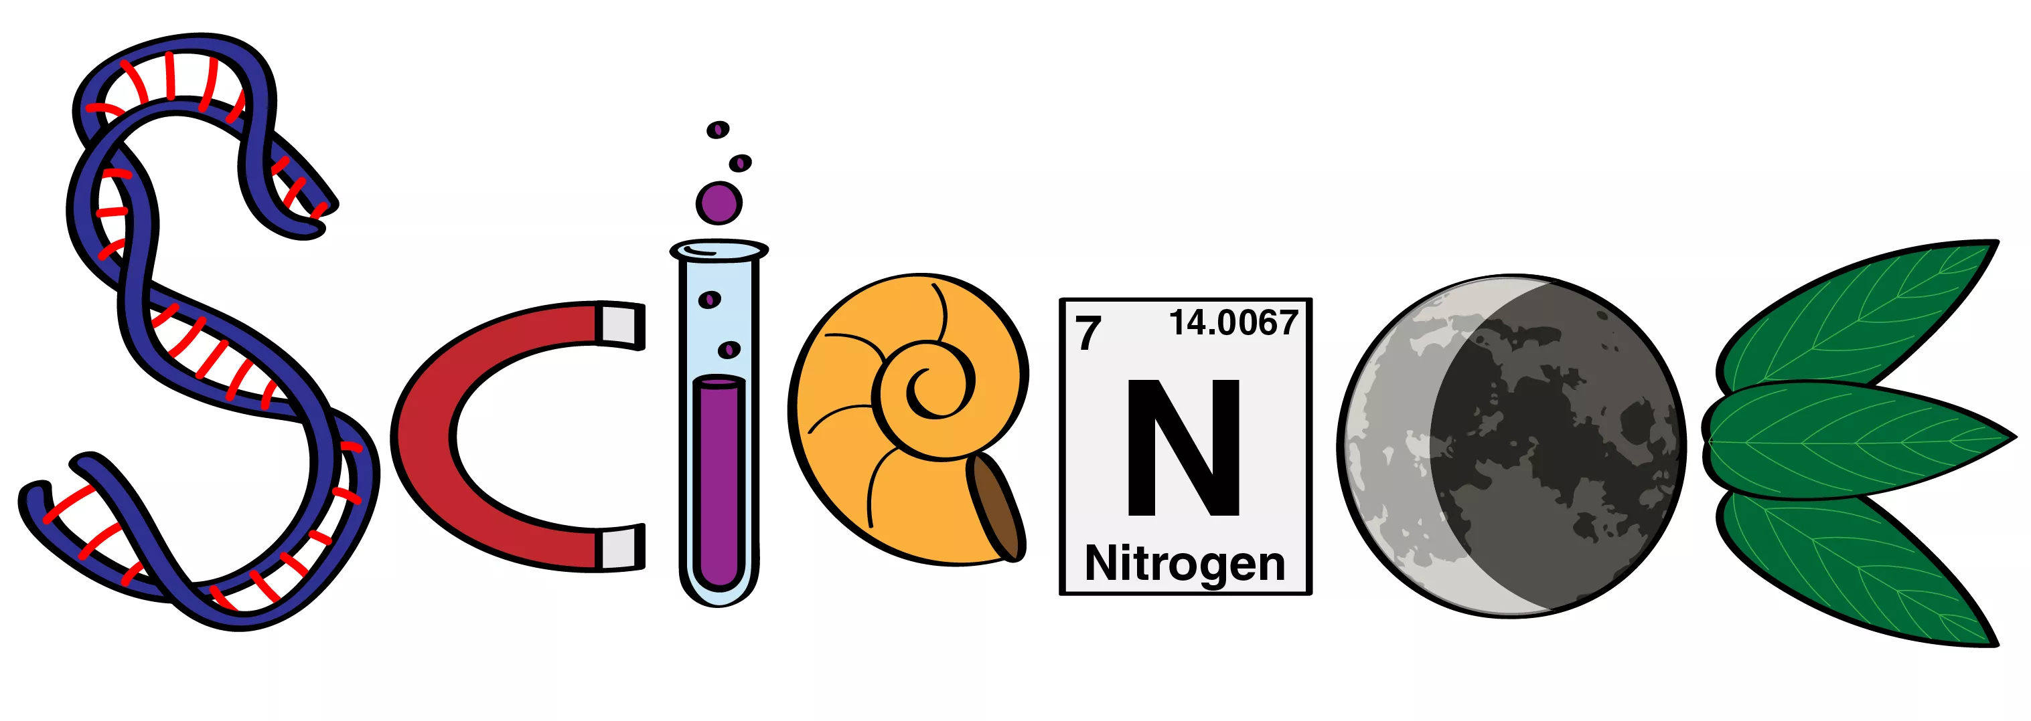
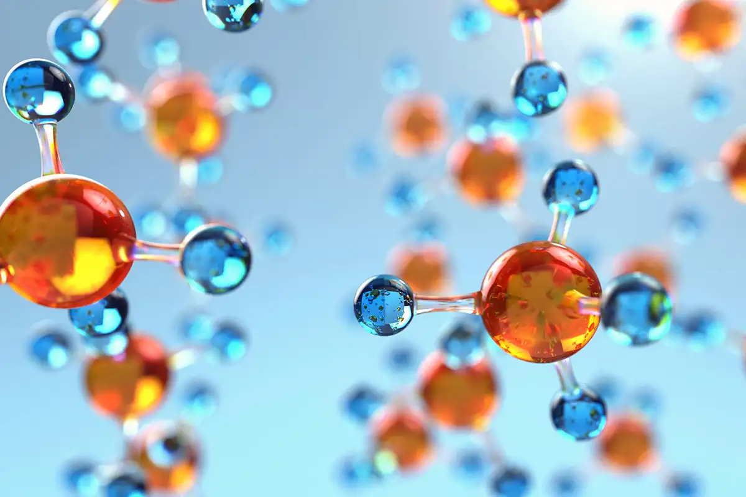
What is Chemistry?
Chemistry is the branch of physical science that studies the composition, structure, properties, and changes of matter. It explains how atoms and molecules interact to form the substances that make up everything in our universe — from the air we breathe to the materials we use every day.
Chemistry connects with physics, biology, and environmental science. It helps us understand natural processes, develop new materials, produce medicines, and generate energy efficiently.

Slide 3
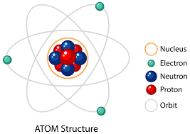
Atoms – the basic units of matter
An atom is the smallest particle of an element that retains its chemical identity. Atoms are composed of three main subatomic particles:
Protons: positively charged particles located in the nucleus.
Neutrons: neutral particles also found in the nucleus.
Electrons: negatively charged particles moving in orbitals around the nucleus.
The nucleus contains almost all the mass of the atom, while electrons determine its chemical behavior. Each element has a unique number of protons — called the atomic number. For example:
Hydrogen has 1 proton,
Oxygen has 8 protons.

Slide 4
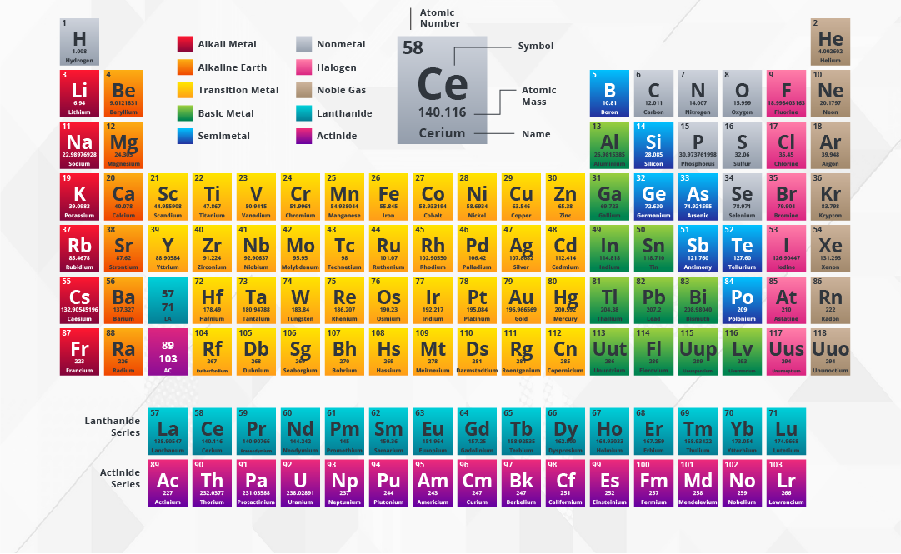
Elements and the Periodic Table
An element is a pure substance consisting of only one type of atom. There are more than 100 known elements, each represented by a chemical symbol (e.g., H for hydrogen, O for oxygen, Na for sodium).
The Periodic Table of Elements organizes all known elements by their atomic number and properties. The Periodic Table is one of the most powerful tools in chemistry — it allows scientists to predict how elements will react and what compounds they can form.

Slide 5
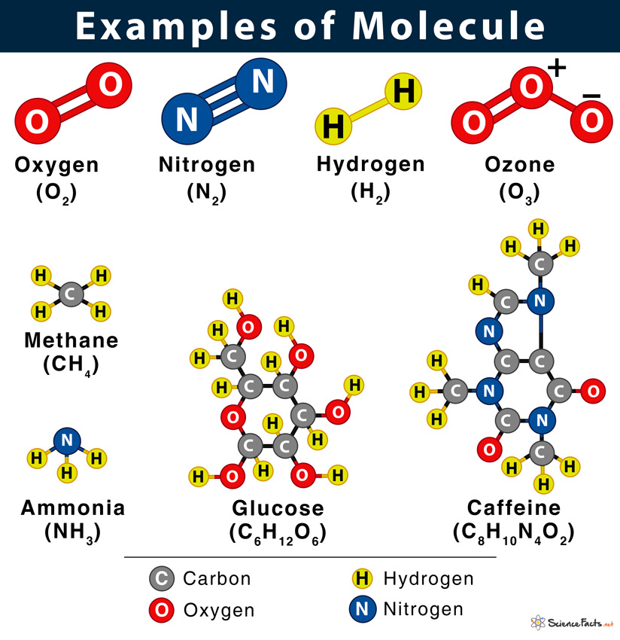
Molecules
Atoms rarely exist alone in nature; they usually combine to form molecules. A molecule is a group of two or more atoms bonded together chemically.

Slide 6
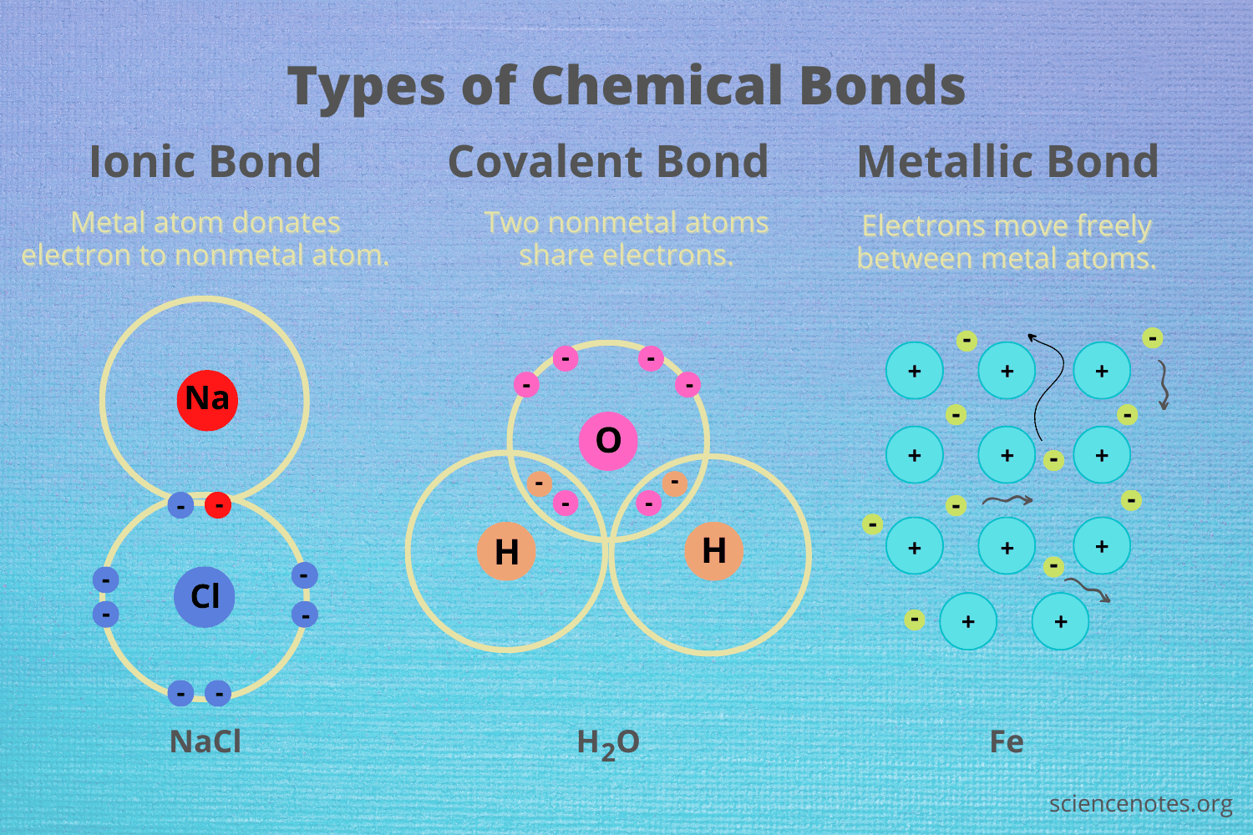
Chemical Bonds
Compounds are substances made of different elements combined in fixed proportions. For instance, water (H₂O) is always made of two hydrogen atoms and one oxygen atom.

Slide 7
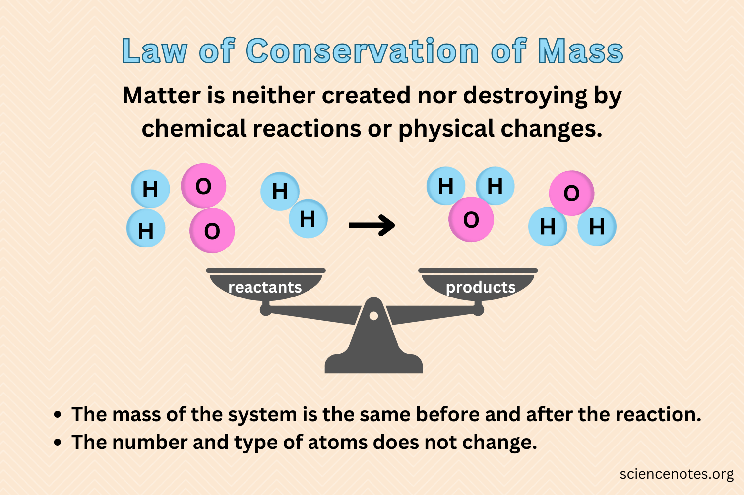
Fundamental laws of chemistry that describe the behavior of matter
Law of Conservation of Mass (Antoine Lavoisier, 1789) – Matter cannot be created or destroyed in a chemical reaction. – The total mass of reactants equals the total mass of products.
If the mass changes, it usually means something has escaped or entered the system (e.g., gas released or absorbed).
This principle is foundational for stoichiometry in chemistry, helping scientists predict how much product will form from given reactants.

Slide 8
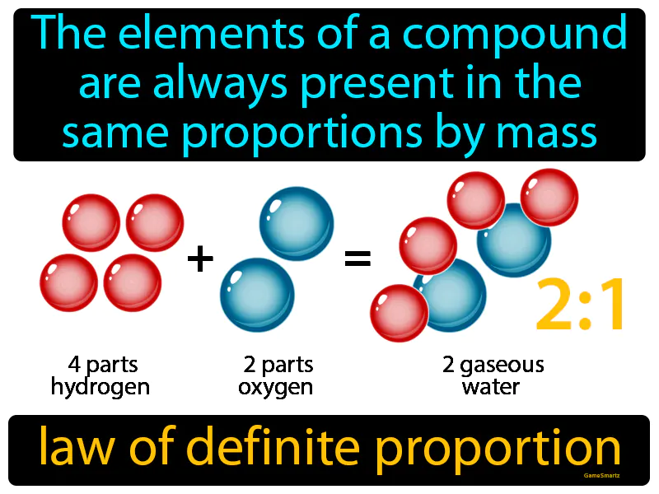
Fundamental laws of chemistry that describe the behavior of matter
Law of Definite Proportions (Joseph Proust, 1799) – A chemical compound always contains the same elements in the same ratio by mass. – Example: Water is always 11.2% hydrogen and 88.8% oxygen by mass.

Slide 9
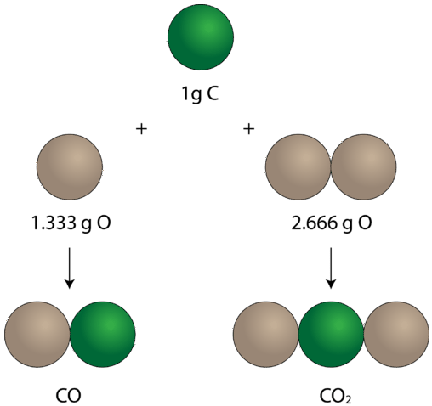
Fundamental laws of chemistry that describe the behavior of matter
Law of Multiple Proportions (John Dalton, 1803) – When two elements form more than one compound, the mass ratios of one element that combine with a fixed mass of the other are simple whole numbers. – Example: CO and CO₂ (carbon and oxygen form two compounds in simple ratios).

Slide 10
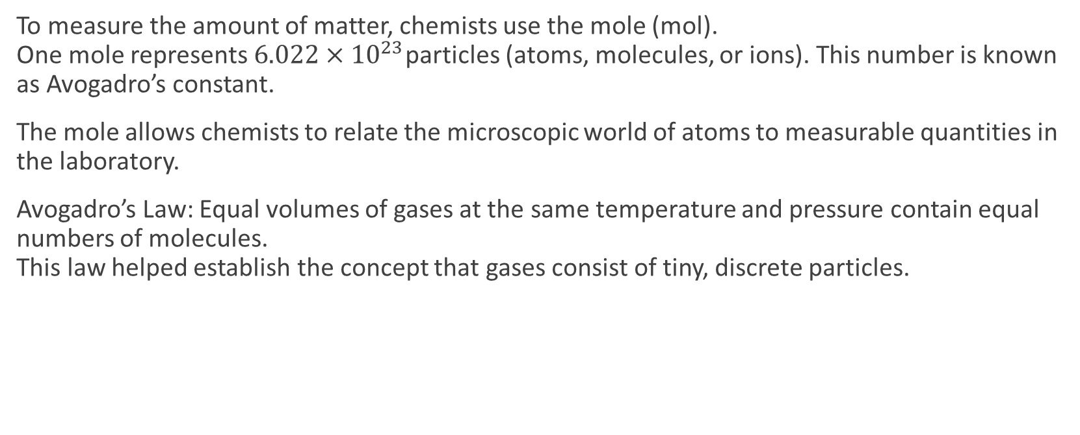
The Mole Concept and Avogadro’s Law
To measure the amount of matter, chemists use the mole (mol). One mole represents $6.022×{10}^{23}$particles (atoms, molecules, or ions). This number is known as Avogadro’s constant.
The mole allows chemists to relate the microscopic world of atoms to measurable quantities in the laboratory.
Avogadro’s Law: Equal volumes of gases at the same temperature and pressure contain equal numbers of molecules. This law helped establish the concept that gases consist of tiny, discrete particles.

Slide 11
Summary
Atoms are the fundamental units of matter, and they combine to form molecules and compounds.
The Periodic Table organizes elements according to their properties and relationships.
The basic laws of chemistry describe how matter behaves and transforms during chemical reactions.
Understanding these principles allows scientists to explain natural phenomena, develop new materials, produce energy, and protect the environment.

Slide 12

Questions?

